Slide 1
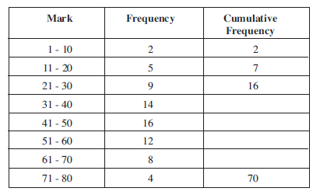
Cumulative Frequency

Slide 2
Cumulative Frequency
30
46
58
66
Notes:
Approximately what proportion of the students had less than 20?
More than 20?

Slide 3
Lecture 5
Describe the Graphs

Slide 4
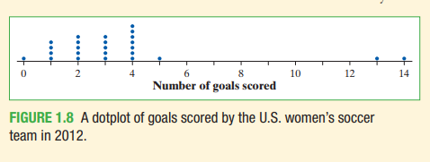
The purpose of a graph is to help us understand the data. After you make a graph, always ask,
“What do I see?”

Slide 5
SOCS (shape, outliers, center, spread)
How to Examine the Distribution of a Quantitative Variable
1. overall pattern of a distribution:
Center
Spread
Shape: concentrate on the main features
- major peaks, clusters of values and obvious gaps
- Look for rough symmetry or clear skewness.
2. Striking departures:
Note individual values that fall outside the overall pattern.
These departures are called outliers.

Slide 6
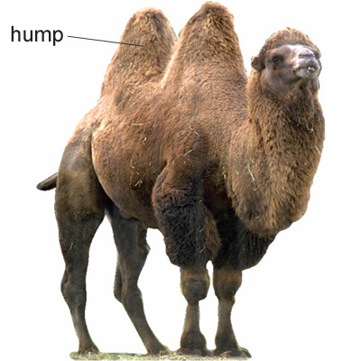
Shape：peaks/clusters/modes
Humps in a graph are called modes.
- no peak: uniform
????

Slide 7
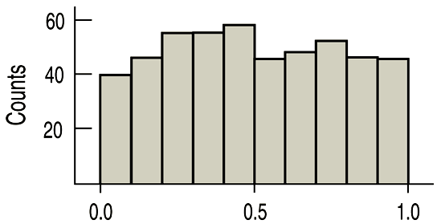
A histogram that doesn’t appear to have any mode and in which all the bars are approximately the same height is called uniform:

Slide 8
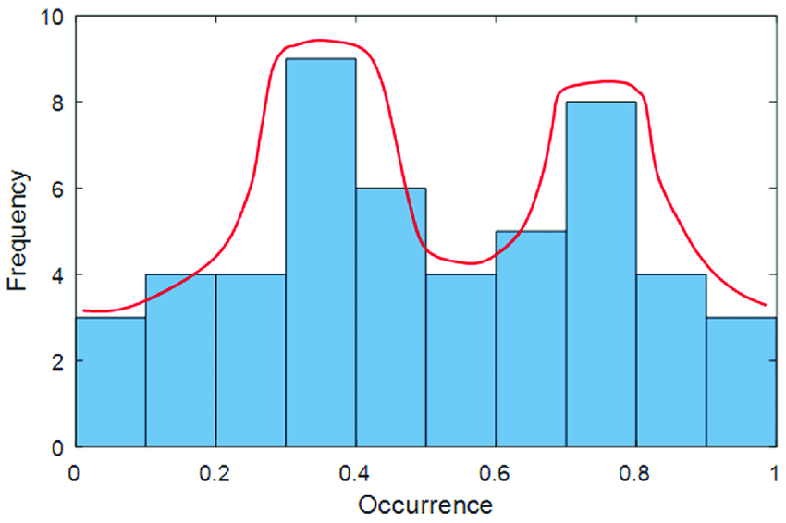
Shape：peaks/clusters/modes
Humps in a graph are called modes.
- no peak: uniform
- one main peak： unimodal
- two peaks： bimodal
- three or more peaks： multimodal

Slide 9
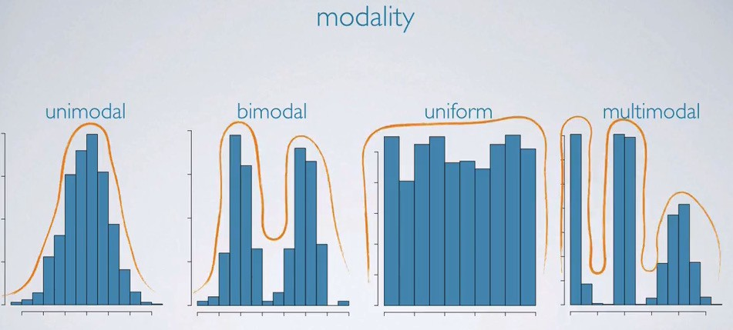
Shape：peaks/clusters/modes

Slide 10
Definitions:
A distribution is roughly symmetric if the right and left sides of the graph are approximately mirror images of each other.
A distribution is skewed to the right (right-skewed) if the right side of the graph (containing the half of the observations with larger values) is much longer than the left side.
It is skewed to the left (left-skewed) if the left side of the graph is much longer than the right side.
left-skewed
symmetric
right-skewed
Notes:
10

Slide 11
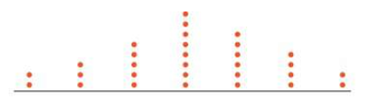
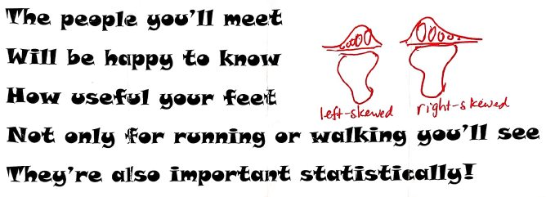
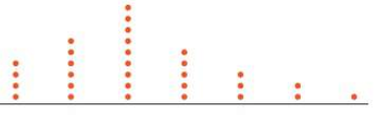
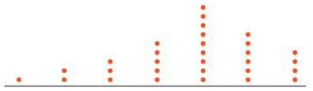
Shape: symmetry/skewness

Slide 12
For brevity, we sometimes say “left-skewed” instead of “skewed to the left” and “right-skewed” instead of “skewed to the right”
We could also describe a distribution with a long tail to the left as “skewed toward negative values” or “negatively skewed” and a distribution with a long right tail as “positively skewed.”
The direction of skewness is the direction of the long tail, not the direction where most observations are clustered.

Slide 13
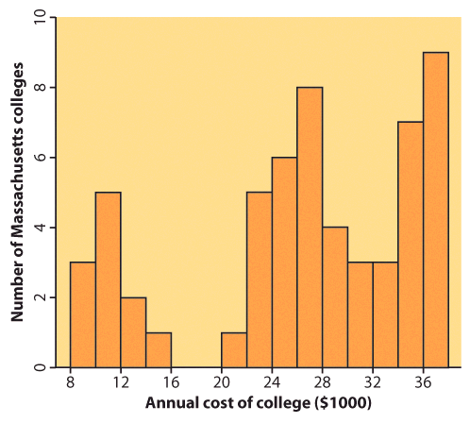
Not all distributions have a simple overall shape.
Complex,
multimodal distribution

Slide 14
Anything Unusual?
Don’t forget to make note of any unusual features denoted in the shape of the distribution. Sometimes it’s the unusual features that tell us something interesting or exciting about the data. You should always mention any outliers that stand off away from the body of the distribution.
A large gap in the distribution is typically a sign of an outlier.

Slide 15
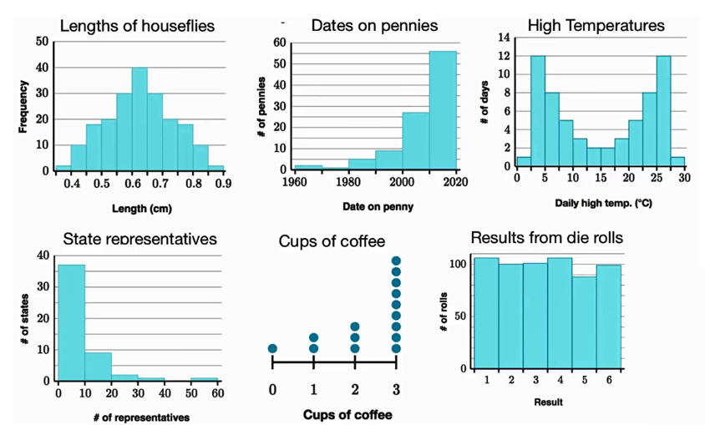

Slide 16
SOCS (shape, outliers, center, spread)
Shape: The dotplot has a peak at 4, a single main cluster of dots between 0 and 5, and a large gap between 5 and 13. The main cluster has a longer tail to the left of the peak than to the right.
What does this shape tell us?
The U.S. women’s soccer team scored between 0 and 5 goals in most of its games, with 4 being the most common value (known as the mode).

Slide 17
Center: The midpoint is at 3.
What does this number tell us? In a typical game during the 2012 season, the U.S. women’s soccer team scored about 3 goals.
Spread: The data vary from 0 goals scored to 14 goals scored.
Outliers: The games in which the women’s team scored 13 goals and 14 goals clearly stand out from the overall pattern of the distribution. So we label them as possible outliers.

Slide 18
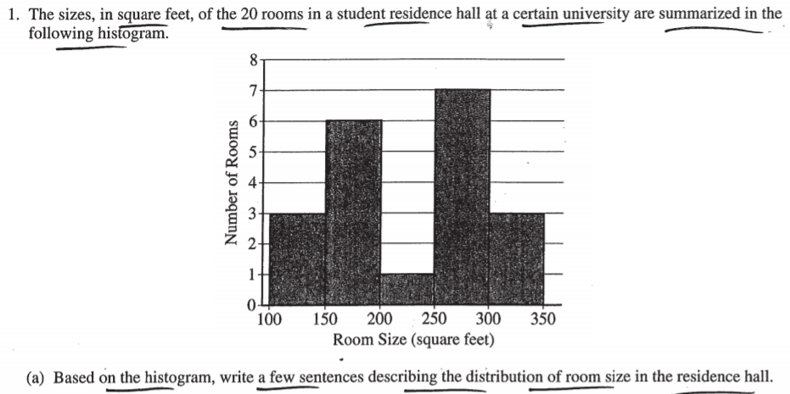

Slide 19
When asked to compare graphs/distributions:
1. use comparison language
2. discuss
shape (skew/approximately normal—while…)
center (greater/less than, etc.)
spread (larger/smaller than, etc.)
unusual values/outliers
3. include context

